Slide 1
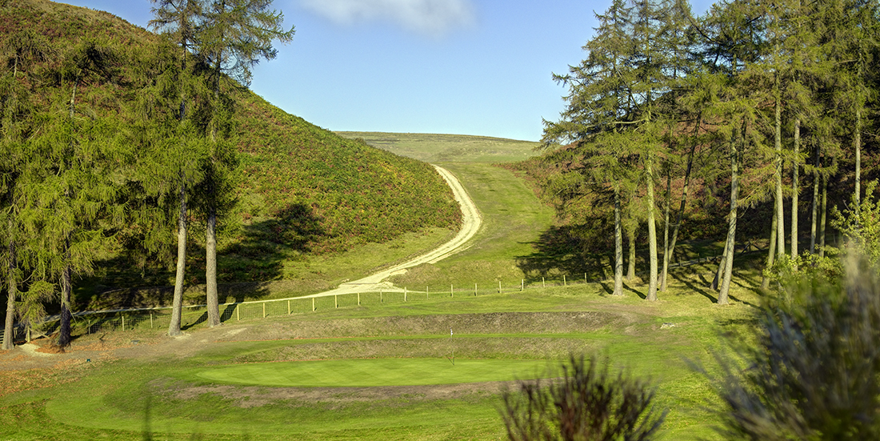
Church Stretton Golf Club: ‘New member offers for 2024’
Offer 1: Join as a group of 3 or more new members and you will each receive a 25% discount off your first 12 months of full membership.
Offer 2: If a ‘current’ full paying member introduces a ‘new’ full paying member they will receive 10% discount on their subscription fees
Offer 3: 12 month new member taster offer - 10% off your first 12 months of full membership.
No winter greens or tees, plenty of tee times available at all times and play golf in stunning scenery
Please notify the membership secretary upon application to claim your offer
Only one offer may be claimed per golfer
Current members claiming against the offer must email the Golf Club manager on pro@churchstrettongolfclub.co.uk
Full membership = all membership categories aged 18yrs+

Slide 2
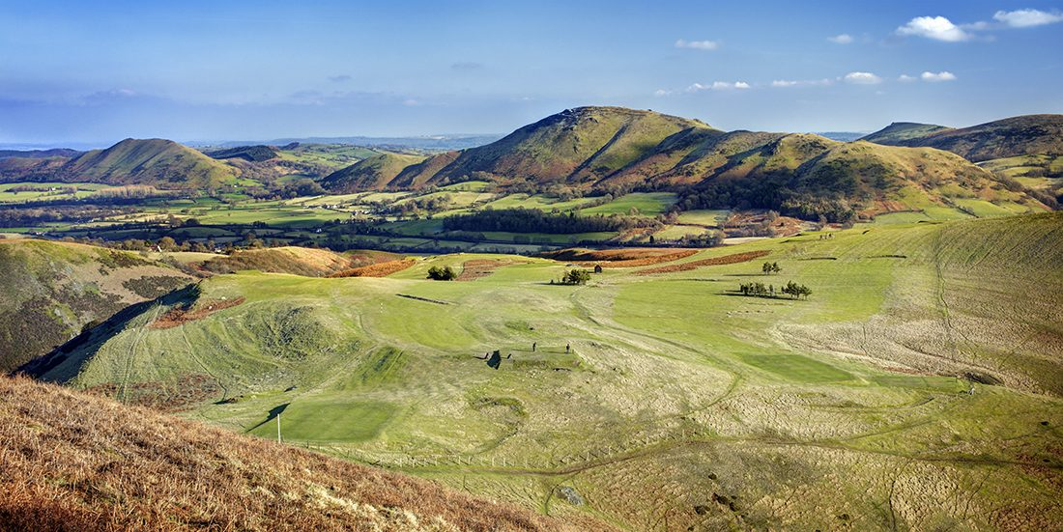
Church Stretton Golf Club: ‘New member offer for 2024’
Join as a group of 3 or more new members and you will each receive a 25% discount off your first 12 months of full membership.
No winter greens or tees, plenty of tee times available at all times and play golf in stunning scenery
Please notify the membership secretary upon application to claim your offer
Full membership = all membership categories aged 18yrs+

Slide 3
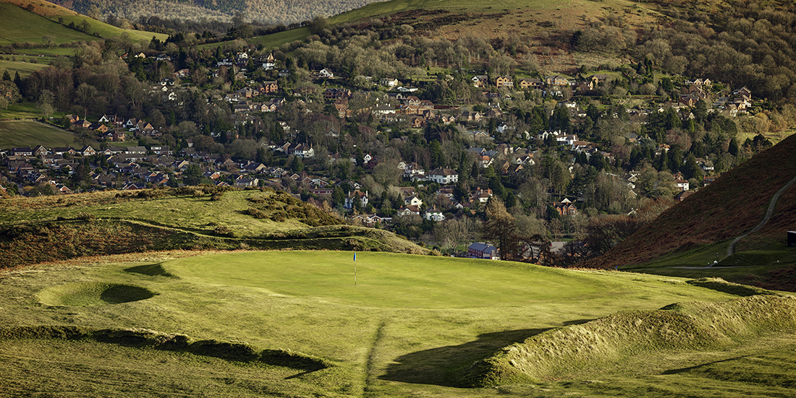
Church Stretton Golf Club: ‘New member offer for 2024’
If a ‘current’ full paying member introduces a ‘new’ full paying member they will receive 10% discount on their subscription fees
No winter greens or tees, plenty of tee times available at all times and play golf in stunning scenery
Please notify the membership secretary upon application to claim your offer
Current members claiming against the offer must email the Golf Club manager on pro@churchstrettongolfclub.co.uk
A new member can only be claimed against once in this offer
Full membership = all membership categories aged 18yrs+

Slide 4
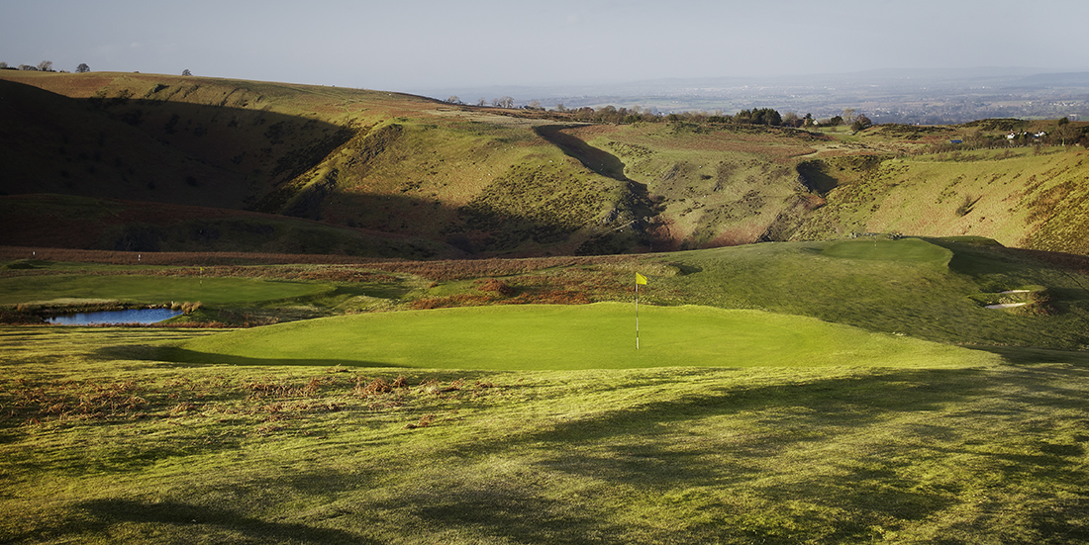
Church Stretton Golf Club: ‘New member offer for 2024’
12 month new member taster offer - 10% off your first 12 months of full membership.
No winter greens or tees, plenty of tee times available at all times and play golf in stunning scenery
Please notify the membership secretary upon application to claim your offer
Current members claiming against the offer must email the Golf Club manager on pro@churchstrettongolfclub.co.uk
Full membership = all membership categories aged 18yrs+

